Slide 1

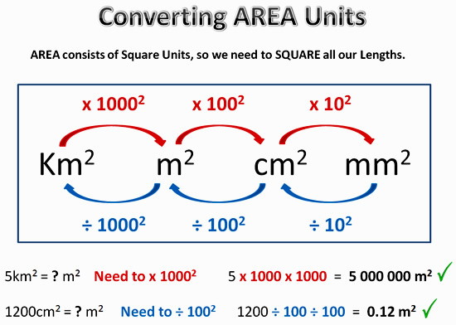
My Measurement Interactive Notebook
Name
Class
Teacher Mr Evans
Term 3 Semester 2
1

Slide 2
Contents
Glossary or Formula Page
Page
Date
Description
2
3

Slide 3
Tasks
24
7
30
Essential Question
Questions
Notes
Summary
6
7

Slide 4
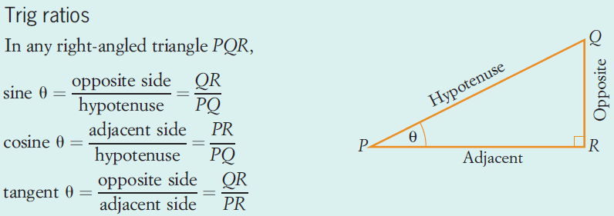
24
7
30
Date
Trigonometric Ratios
EQ – What are the Trig Ratios and how do they help us determine the lengths of sides in right angled triangles?
What are the Trig Ratios?
5

Slide 5

24
7
30
Date
Trigonometric Ratios
EQ – What are the Trig Ratios and how do they help us determine the lengths of sides in right angled triangles?
What are the Trig Ratios?
5

Slide 6
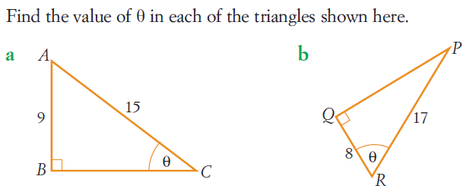
24
7
30
Date
Trigonometric Ratios
EQ – What are the Trig Ratios and how do they help us determine the lengths of sides in right angled triangles?
How do we use the Trig Ratios to find values in a triangle?
5

Slide 7
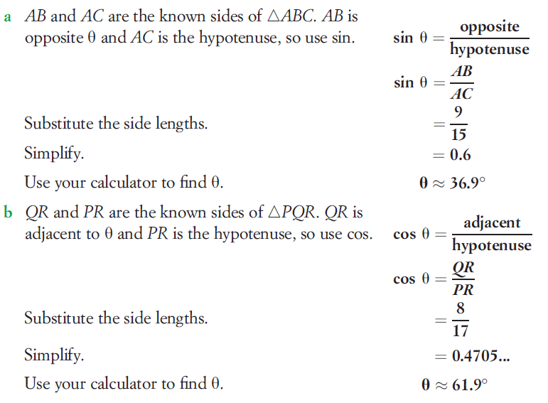
24
7
30
Date
Trigonometric Ratios
EQ – What are the Trig Ratios and how do they help us determine the lengths of sides in right angled triangles?
How do we use the Trig Ratios to find values in a triangle?
5

Slide 8
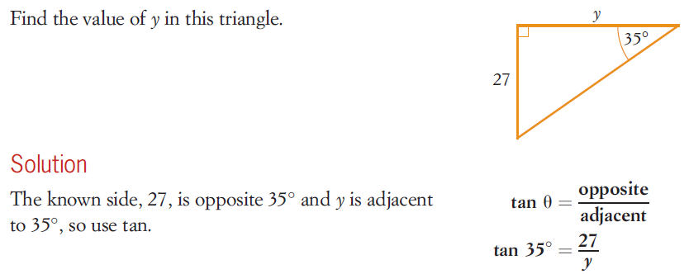
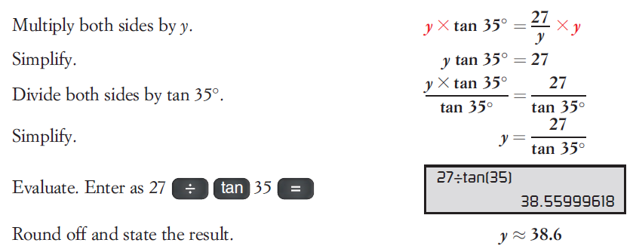
24
7
30
Date
Trigonometric Ratios
EQ – What are the Trig Ratios and how do they help us determine the lengths of sides in right angled triangles?
How do we use the Trig Ratios to find values in a triangle?
5

Slide 9
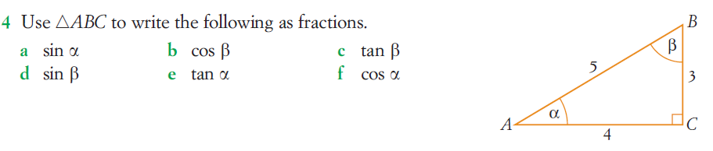
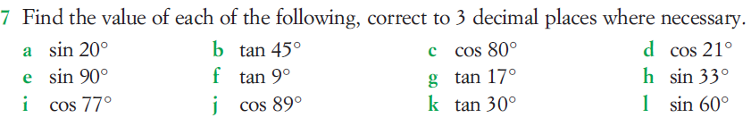
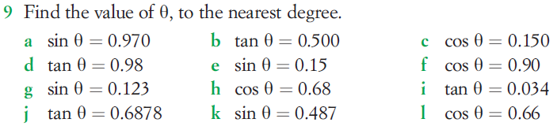
Questions

Slide 10
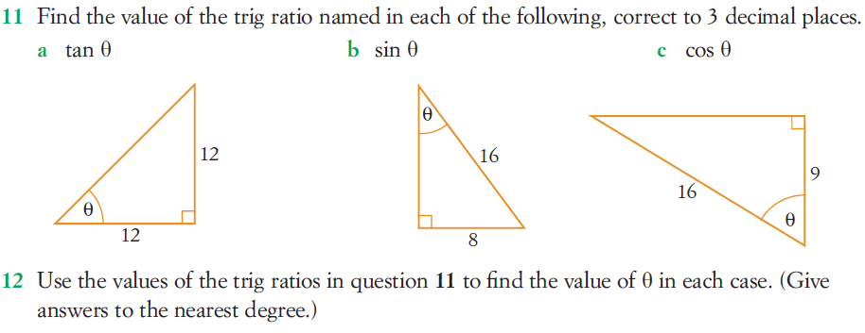
Questions

Slide 11
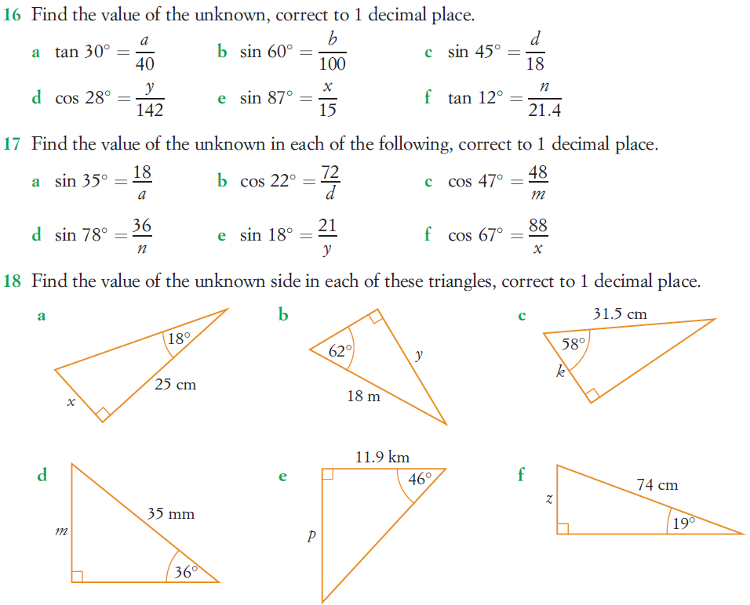
Questions

Slide 12
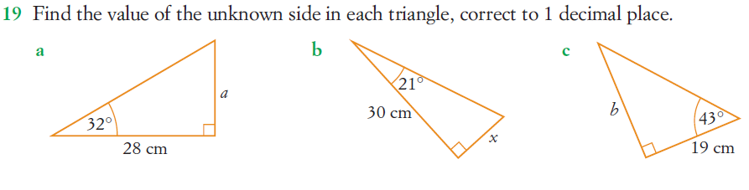
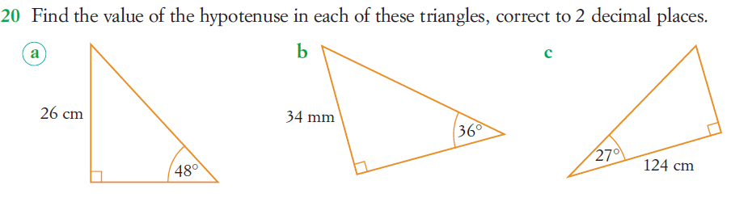
Questions

Slide 13
Answers

Slide 14
Notes Review
24, 7 ,30
Date
Title
Essential question
Notes complete
Notes complete with colour and diagrams
Questions completed
Contents page filed in
Formula page filled in

Slide 15
Homework
Review your notes and write a summary answering the essential question.

